Slide 1

Enhanced Guidelines to the
Code of Conduct for
Trans-Tasman Patent and Trade Marks Attorneys
Professor Andrew Christie
Chair, Trans-Tasman IP Attorneys Board
IPTA • NZIPA • TTIPAB webinar
27 June 2023

Slide 2
Why make Enhancements?
Response to findings of the 2021 ‘Health Check’ of the Code of Conduct
  Awareness and understanding of the Code?
    generally satisfactory
    scope to improve among junior attorneys
    significant scope to improve among clients without an attorney on staff
  Deficiencies or problems with the Code?
    no major deficiencies or problems with content
    significant scope to provide more guidance on application of content on specific issues

Slide 3
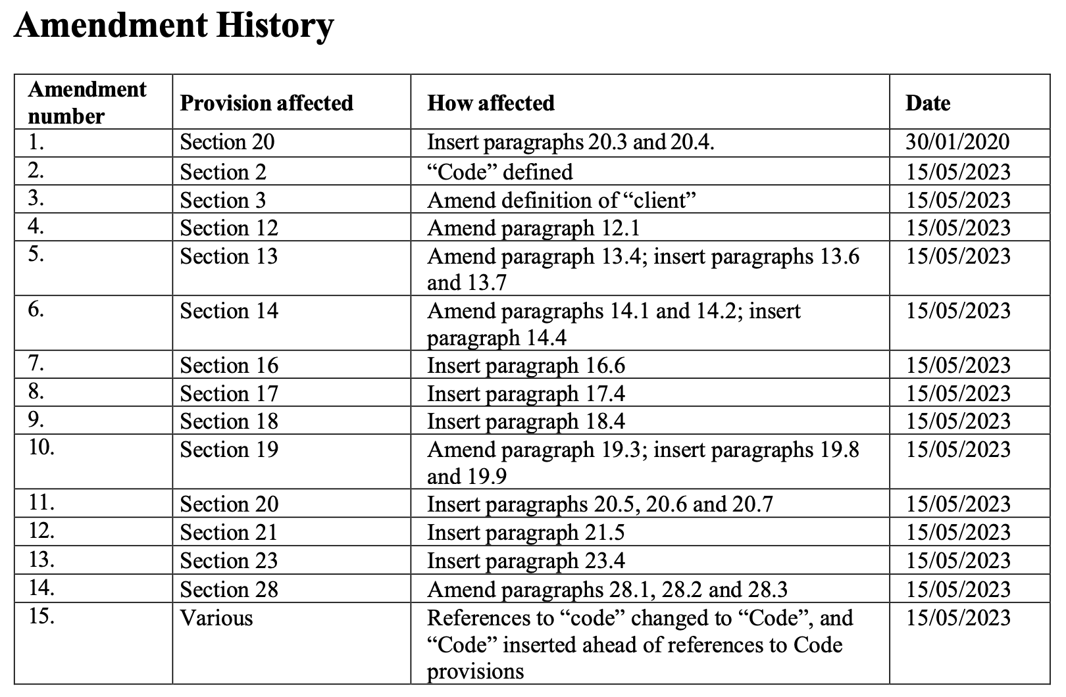

Slide 4
Enhancements – Conflicts (s.20)
Concern | Guidelines
An attorney may fail to check for conflicts when an attorney from another firm is recruited or when firms merge | New para 20.5 Obligation to avoid the creation of actual or reasonable possibility of conflict is ongoing – i.e., extends beyond initial acceptance of work Attorney should monitor for actual or reasonable possibility of conflict throughout the life of a matter, especially when a major change in the conduct of the attorney’s practice occurs – e.g., new staff or merger

Slide 5
Enhancements – Conflicts (s.20) cont.
Concern | Guidelines
An attorney may put themselves in the position of actual or possible conflict if they take a proprietary or financial interest in IP rights in respect of which the attorney is acting for a client | New para 20.6 Significant care is required Before taking and while holding an interest in client’s IP rights, must assess for potential of attorney’s and client’s interest to come into conflict Where is actual or reasonable possibility of conflict, must take all reasonable steps to avoid/resolve conflict - may require attorney to not act or hold interest, or cease to do so

Slide 6
Enhancements – Conflicts (s.20) cont.
Concern | Guidelines
An attorney may put themselves in the position of actual or possible conflict if they act as the named opponent in a “strawperson” opposition | New para 20.7 Strong possibility of a conflict of interest arising, so very significant care is required Before and while acting, must assess for potential of attorney’s interest and client’s interest to come into conflict Where is actual or reasonable possibility of conflict, must take all reasonable steps to avoid/resolve conflict - may require attorney to not act or to cease to act

Slide 7
Enhancements – Loyalty (s.19)
Concern | Guidelines
An attorney should not act to oppose or invalidate an IP right the application for which the attorney drafted and/or prosecuted on behalf of a former client | New para 19.8 Former clients owned a duty of confidentiality, but not a duty of loyalty Nevertheless, an attorney should not act to oppose/invalidate an IP application they have drafted, because it would undermine the integrity of the profession in the eyes of the public

Slide 8
Enhancements – Loyalty (s.19) cont.
Concern | Guidelines
An attorney doing work under contract with another attorney may fail to consider who is the client for the purpose of the loyalty obligations | New para 19.9 An attorney must be vigilant in identifying clients to whom an obligation of loyalty is owed “Client” is the person for whom the benefit of work is undertaken, which is not the necessarily the person instructing the work to be done Loyalty duties operate in respect of all persons for whom an attorney undertakes work, both on own account and under contract with another attorney

Slide 9
Enhancements – Disclosure (s.17)
Concern | Guidelines
An attorney might “white label” work of another attorney, with the client not aware of who has done the work | New para 17.4 A client should know the identity of the person who has undertaken attorney work for them Duty of disclosure requires an attorney to inform the client of the identity of any person who has undertaken attorney work for the client, where that person is not the attorney or a member of the attorney’s firm

Slide 10
Enhancements – Confidentiality (s.18)
Concern | Guidelines
An attorney may not treat as confidential information disclosed by a client, of which the attorney was not aware, but which could have been ascertained by the search of a register | New para 18.4 Characteristic of being confidential is relative, not absolute Information disclosed by a client (e.g., about an application for an IP right) that is not generally available and was not previously known by attorney is to be treated as confidential, even if it could have been ascertained from a public source (e.g., by searching a register), if doing so requires not insignificant effort

Slide 11
Enhancements – Competency (s.14)
Concern | Guidelines
An attorney working outside core attorney practice (e.g., advising on finance, taxation, IP asset auditing) may not have sufficient expertise | Revised paras 14.1 and 14.2 Obligations of competency, and reasonable skill/care, apply to all work undertaken by an attorney - not just drafting/prosecuting IP rights applications and advising on validity/infringement of IP rights The work an attorney must not undertake without suitable competency includes finance, taxation, IP asset auditing, licensing, competition law

Slide 12
Enhancements – Competency (s.14)
Concern | Guidelines
An attorney may receive instructions orally, or give advice orally, without making file notes | New para 14.4 Difficulties can arise where instructions and advice are provided orally, as recollections may differ Unless client expressly instructs otherwise, a written record of oral instructions and advice should be made and supplied to client

Slide 13
Enhancements – Integrity (s.13)
Concern | Guidelines
An attorney’s critical commentary about another attorney might be regarded as “crossing the line” of acceptable conduct | Revised para 13.4 An attorney must exercise caution when commenting on the practice or behaviour of another attorney Commentary that is subjective and inaccurate may breach the obligation of integrity

Slide 14
Enhancements – Integrity (s.13) cont.
Concern | Guidelines
Unlike the legal professions’ code of conduct, the Code does not expressly prohibit harassment, bullying, etc. | New para 13.6 Behaviour that constitutes unlawful discrimination, harassment, bullying or violence is inconsistent with the obligation of integrity Obligation not to behave in this manner applies to all persons with whom attorney engages professionally

Slide 15
Enhancements – Independence (s.21)
Concern | Guidelines
An attorney may become aware only very close to the deadline for acting that they are being instructed to act in a proceeding against a client of another member of their ownership group | New para 21.5 [≈ current para 20.4] Take (only) the urgent action that is necessary to maintain the client’s rights, even though the registered attorney has not yet received (and may not receive) the client’s informed consent to act

Slide 16
Enhancements – Ownership (s.23)
Concern | Guidelines
Group firms are not clearly disclosing to the public their membership of an ownership group and the identity of the other members of that group | New para 23.4 What constitutes clear disclosure to the public is not necessarily the same as clear disclosure to a client A group firm should have a prominent, clear and simple presentation of the requisite information about group ownership on its public material, including on the home page of its website

Slide 17
Enhancements – Communication (s.16)
Concern | Guidelines
Clients are not aware of who is responsible for administering the Code of Conduct | New para 16.6 When an attorney informs a new client that they are bound by the Code of Conduct, identify, and provide the contact details of, the Board as the responsible authority

